Slide 1
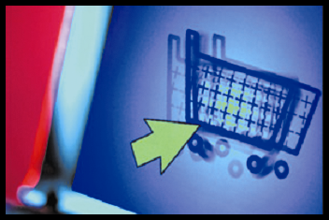
E-commerce
business. technology. society.

Slide 2
Chapter 1
The Revolution Is Just Beginning

Slide 3
E-commerce Developments and Themes
More and more people and businesses are using the Internet to conduct commerce
The e-commerce channel is depending as more products and services come online
Broadband and wireless Internet access are growing
E-commerce business models are being refined to achieve higher levels of profits.
At societal level, there is continued conflict over copyrights, content regulation, taxation, privacy, and Internet fraud.

Slide 4
E-commerce Defined
E-commerce involves digitally enabled commercial transactions between and among organizations and individuals
Digitally enabled transactions include all transactions mediated by digital technology
Commercial transactions involve the exchange of value across organizational or individual boundaries in return for products or services

Slide 5
Advantages of E-Commerce over commerce
Cost Effective
Time Saving
Convenience
Geographically Accessible
Introduction of new products
Profit
Time Accessibility
Process

Slide 6
Cost Effective
E-commerce is very cost effective when compared to traditional commerce. In traditional commerce, cost has to be incurred for the role of middlemen to sell the company’s product. The cost incurred on middlemen is eliminated in e-commerce as there is a direct link between the business and the customer. The total overhead cost required to run e-business is comparatively less, compared to traditional business.
For example, in running an e-business, only a head office is required. Whereas in traditional method, a head office with several branches are required to cater to the needs of customers situated in different places. The cost incurred on labour, maintenance, office rent can be substituted by hosting a website in e-business method.

Slide 7
Time Saving
It takes a lot of time to complete a transaction in traditional commerce. E-commerce saves a lot of valuable time for both the consumers and business. A product can be ordered and the transaction can be completed in few minutes through internet.

Slide 8
Convenience
E-commerce provides convenience to both the customers and the business. Customers can browse through a whole directories of catalogues, compare prices between products and choose a desired product any time and anywhere in the world without any necessity to move away from their home or work place.
E-commerce provides better connectivity for its prospective and potential customers as the organization’s website can be accessed virtually from anywhere, any time through internet. It is not necessary to move away from their work place or home to locate and purchase a desired product.

Slide 9
Geographical Accessibility
In traditional commerce, it may be easy to expand the size of the market from regional to national level. Business organizations have to incur a lot of expenses on investment to enter international market. In e-commerce it is easy to expand the size of the market from regional to international level.
By hosting a website, by placing advertisements on the internet and satisfying certain legal norms, a business can penetrate into global market. It is quite easy to attract customers from global markets at a marginal cost.

Slide 10
Introduction of new products
In traditional commerce, it takes a lot of time and money to introduce a new product and analyze the response of the customers. Initially, cost has to be incurred to carry out pilot surveys to understand the taste of the customers.
In e-commerce, it is easy to introduce a product on the website and get the immediate feedback of the customers. Based on the response, the products can be redefined and modified for a successful launch.

Slide 11
Profit
E-commerce helps to increase the sales of the organization. It helps the organization to enjoy greater profits by increasing sales, cutting cost and streamlining operating processes.
The cost incurred on the middlemen, overhead, inventory and limited sales pulls down the profit of the organization in traditional commerce.

Slide 12
Time Accessibility
Business is open only for a limited time in traditional commerce. Round the clock (24 x 7) service is available in e-commerce.

Slide 13
Process
There is an automated processing of business transactions in electronic commerce. It helps to minimize the clerical errors.
There is manual processing of business transactions in traditional commerce. There are chances of clerical errors to occur as human intervention takes place.

Slide 14
Dis-advantages of E-Commerce over commerce
Physical Inspection
Product Suitability
Human Resource
Customer Interaction
Business Relationship
Fraud

Slide 15
Physical Inspection
E-commerce does not allow physical inspection of goods. In purchasing goods in e-commerce, customers have to rely on electronic images whereas in traditional commerce, it is possible to physically inspect the goods before the purchase.

Slide 16
Product Suitability
E-commerce is not suitable for perishable goods and high valuable items such as jewellery and antiques. It is mostly suitable for purchasing tickets, books, music and software. Traditional commerce is suitable for perishables and touch and feel items. Purchasing software, music in traditional commerce may appear expensive

Slide 17
Human Resource
To operate in electronic environment, an organization requires technically qualified staff with an aptitude to update themselves in the ever changing world. E-business has difficulty in recruiting and retaining talented people.
Traditional commerce does not have such problems associated with human resource in non electronic environment.

Slide 18
Customer Interaction
In traditional commerce, the interaction between the business and the consumer is a “face-to-face”.
In electronic commerce, the interaction between the business and the consumer is “screen-to-face”. Since there is no personal touch in e-business, companies need to have intimate relationship with customers to win over their loyalty.

Slide 19
Business Relationship
The business relationship in traditional commerce is vertical or linear, whereas in electronic commerce the business relationship is characterized by end-to-end.

Slide 20
Fraud
Lot of cyber frauds take place in electronic commerce transactions. People generally fear to give credit card information. Lack of physical presence in markets and unclear legal issues give loopholes for frauds to take place in e-business transactions.
Fraud in traditional commerce is comparatively less as there is personal interaction between the buyer and the seller.

Slide 21
E-commerce vs. E-business
We use the term e-business to refer primarily to the digital enablement of transactions and processes within a firm, involving information systems under the control of the firm
E-business does not include commercial transactions involving an exchange of value across organizational boundaries

Slide 22
Why Study E-commerce?
E-commerce technology is different and more powerful than any of the other technologies that we have seen in the past century.
E-commerce has challenged much traditional business thinking
E-commerce has a number of unique features that help to explain why we have so much interest in e-commerce.

Slide 23
The Reinvention of E-Commerce
1995-2000 , Innovation
Digitize business on the web
Weak business models
Liquidity bubble
2001-2008, Consolidation
Honed business models, 25% growth per year
Success of social networking services

Slide 24
Where is E-Commerce Today
Trends in 2008-2009
New business models based off social technologies
Growth in search engine marketing & advertising
Retail ecommerce grows in double digit rates
Online population slows but average purchase expands
Fastest growth in older shoppers

Slide 25
Ecommerce today (cont.)
Revolution in telecommunications, print media, real estate, hotels, bill payments
Entrepreneurs flood the net, riding on infrastructures of Amazon, eBay and Google
Large companies continue to improve multi-channel, bricks & clicks models
Growth in B2B supply chain use of the web

Slide 26
Seven Unique Features of E-commerce Technology and Their Significance
Is ubiquitous (available everywhere, all the time)
Offers global reach (across cultural/national boundaries)
Operates according to universal standards (lowers market entry for merchants and search costs for consumers)
Provides information richness (more powerful selling environment)
Is interactive (can simulate face-to-face experience, but on a global scale)
Increases information density (amount and quality of information available to all market participants)
Permits personalization/customization

Slide 27
Types of E-commerce
Classified by nature of market relationship
Business-to-Consumer (B2C)
Business-to-Business (B2B)
Consumer-to-Consumer (C2C)
Classified by type of technology used
Peer-to-Peer (P2P)
Mobile commerce (M-commerce)

Slide 28
Growth of the Internet
A worldwide network of computer networks built on common standards
Was created in late 1960s
Services include the Web, e-mail, file transfers, etc.
Can measure growth of Internet by looking at number of Internet hosts with domain names

Slide 29
Growth of the Web
The most popular service on the Internet
Developed in early 1990s
Provides access to Web pages (documents created with HTML)
Can include text, graphics, animations, music, videos
Web content in form of Web pages has grown exponentially.

Slide 30
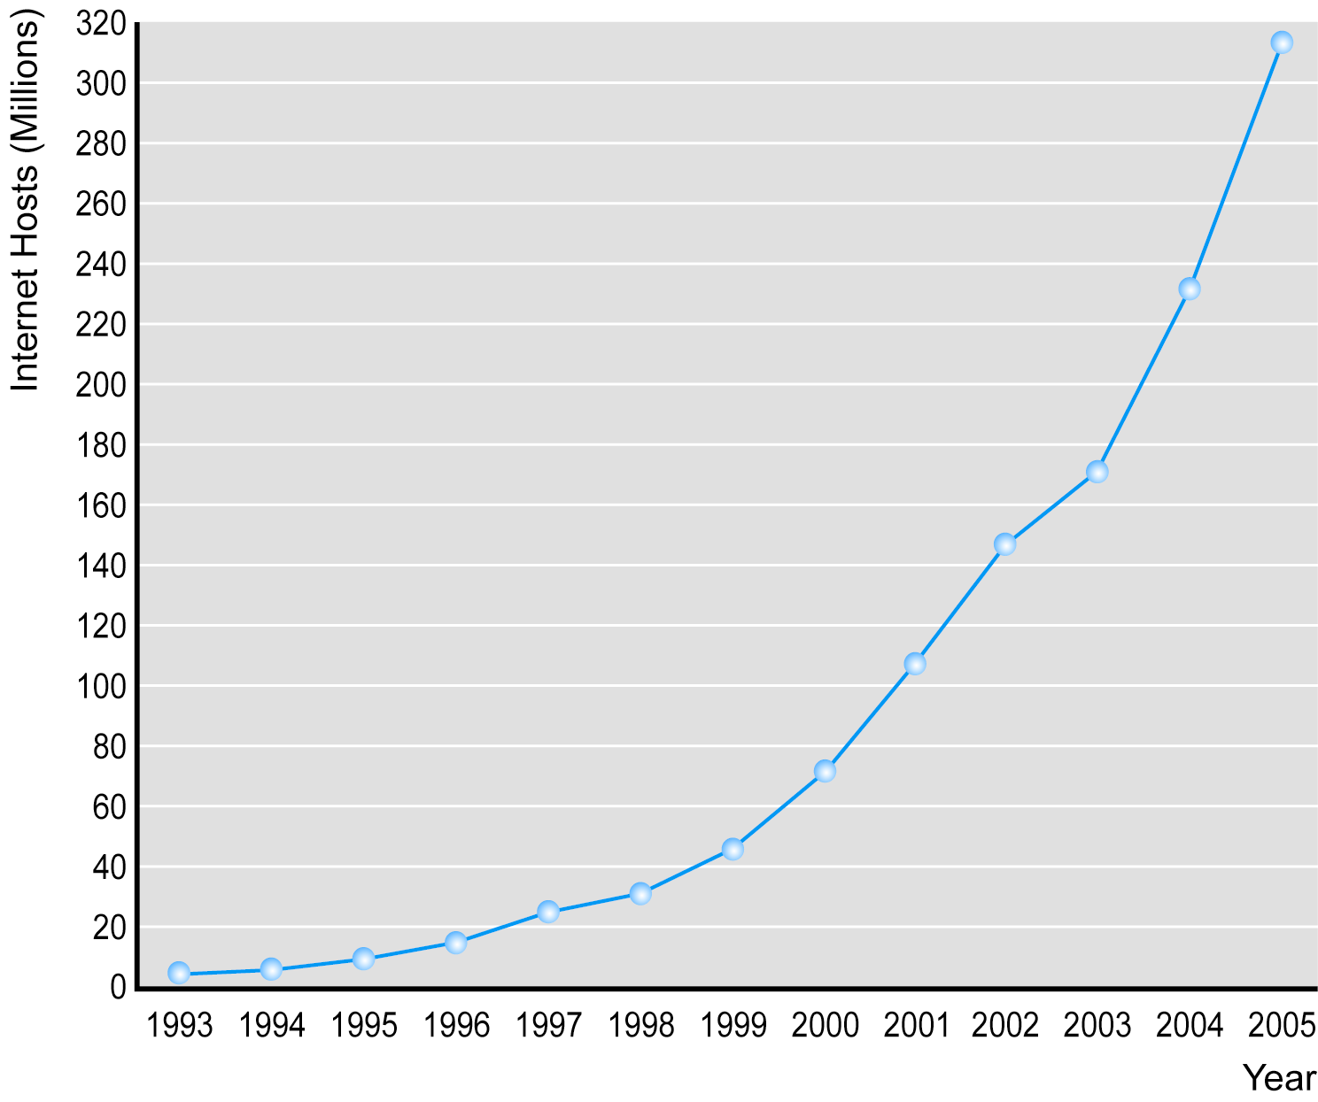
The Growth of the Internet, Measured by Number of Internet Hosts with Domain Names
Figure 1.3, Page 20
SOURCE: Internet Systems Consortium, Inc. (www.isoc.org), 2005.

Slide 31
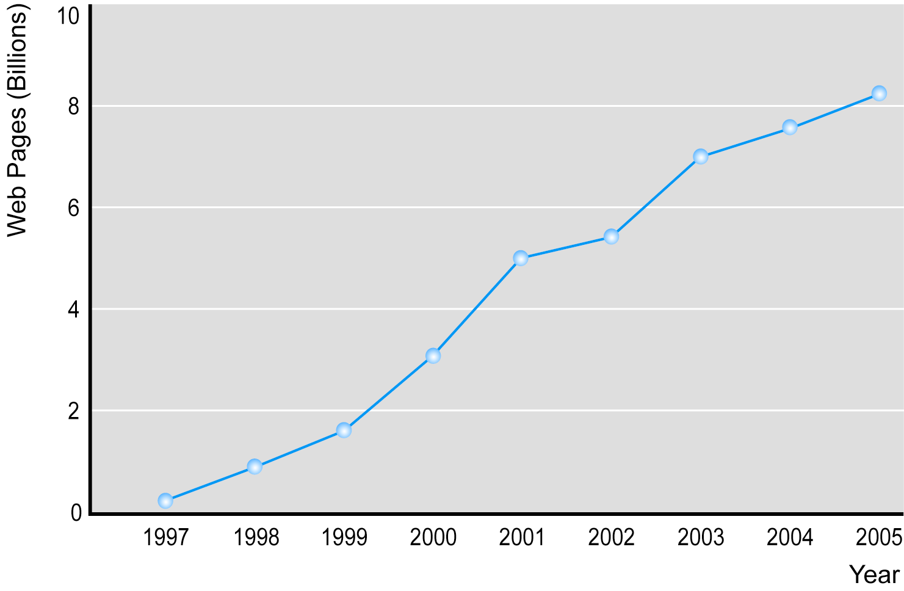
The Growth of Web Content
Figure 1.4, Page 21
SOURCE: Based on data from Google Inc., 2005.

Slide 32
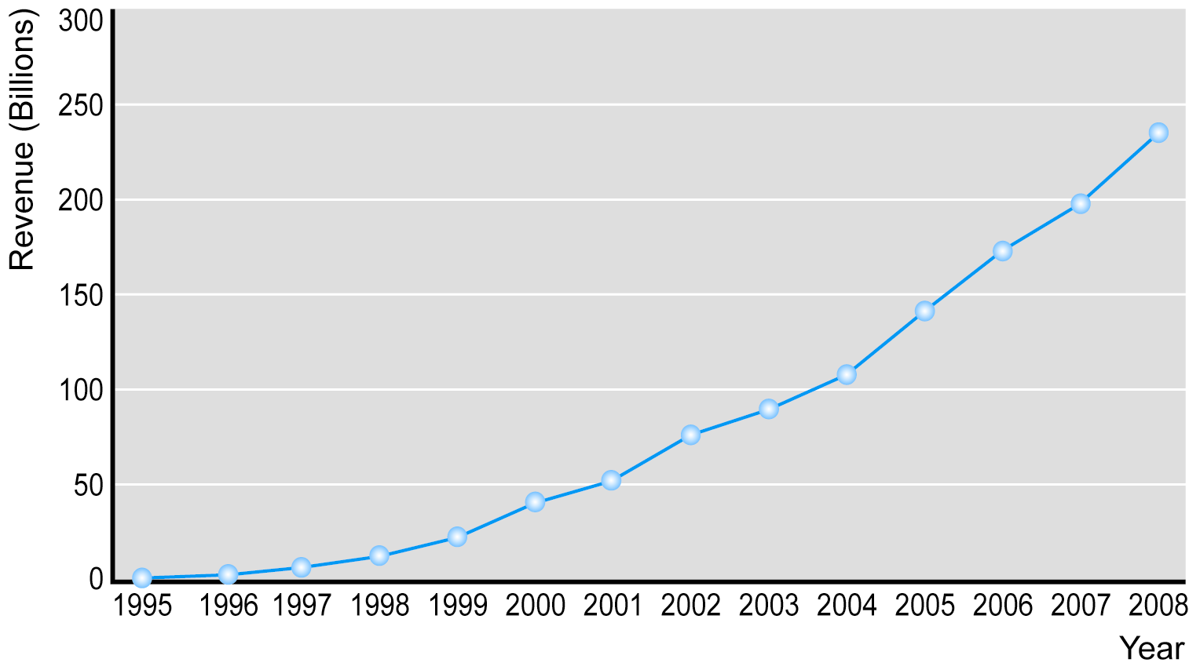
The Growth of B2C E-commerce
Figure 1.5, Page 24
SOURCE: Based on data from eMarketer, Inc., 2005a; Shop.org and Forrester Research, 2005; Forrester Research, 2004.

Slide 33
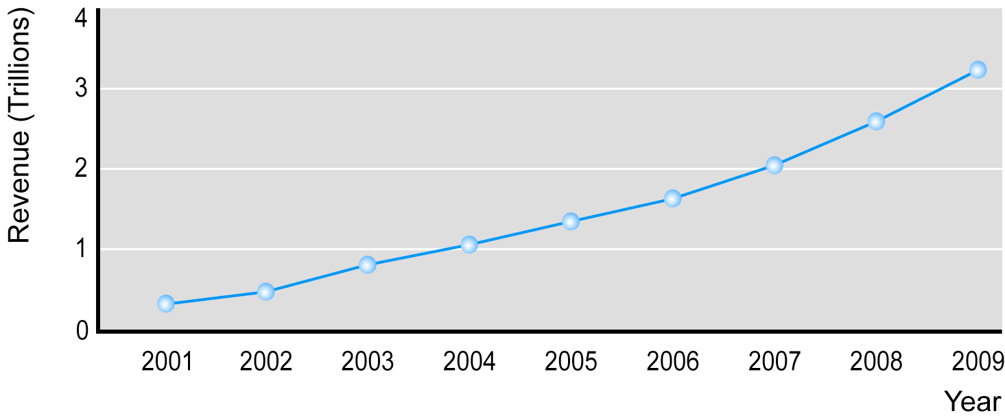
The Growth of B2B E-commerce
Figure 1.6, Page 25
SOURCE: Based on data from e-Marketer, Inc., 2005; U.S. Department of Commerce, 2005; authors’ estimates.

Slide 34
Technology and E-commerce in Perspective
The Internet and Web are just two of a long list of technologies, such as automobiles and radio, that have followed a similar historical path.
Although e-commerce has grown explosively.

Slide 35
Potential Limitations on the Growth of B2C E-commerce
Expensive technology
Complex software interface
Persistent cultural attraction of physical markets and traditional shopping experiences
Persistent global inequality limiting access to telephones and computers

Slide 36
The Visions and Forces Behind E-commerce:
For computer scientists, vindicated a vision of universal communications and computing environment that could be accessed by everyone
For economists, vision of a perfect market and friction-free commerce
For entrepreneurs, their financial backers and marketing professionals, e-commerce represented an extraordinary opportunity to return far above normal returns on investment.

Slide 37
Assessing E-commerce: Successes, Surprises and Failures
E-commerce has been a stunning technological success
Early years of e-commerce have been a mixed success from a business perspective
Many visions developed during early days of e-commerce not fulfilled

Slide 38
Predictions for the Future
Technology of e-commerce will continue to propagate through all commercial activity
E-commerce prices will rise to cover the real cost of doing business on the Web and pay investors reasonable rate of return
E-commerce margins and profits will rise to levels more typical of all retailers
In B2C and B2B, traditional Fortune 500 companies will play growing and dominant role
Number of successful pure online companies will decline and most successful e-commerce firms will adopt mixed “clicks and bricks” strategies
Growth of regulatory activity worldwide

